Slide 1
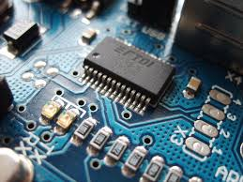
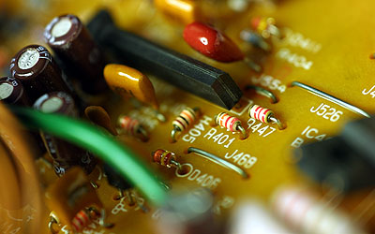

CO2015 Basic Electronic Circuit Components

Slide 2
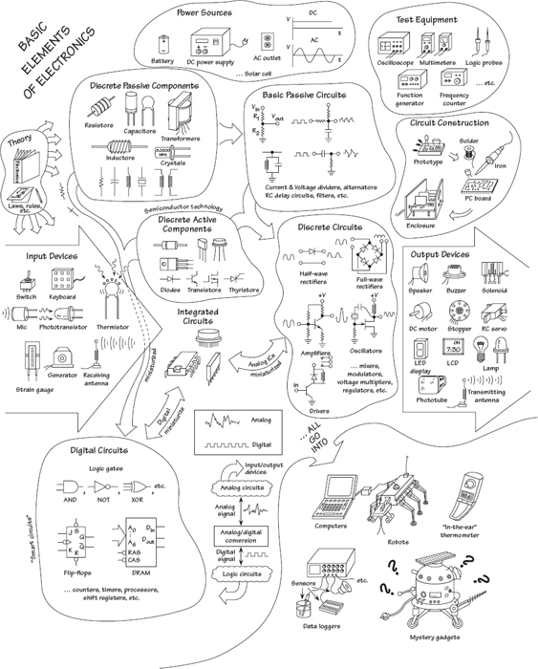
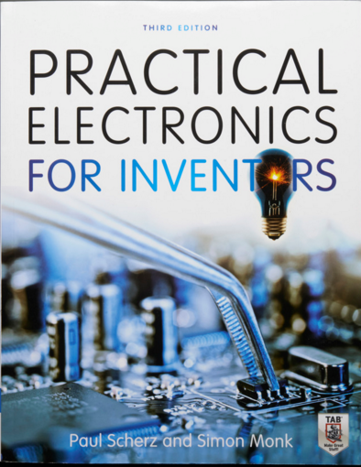

Slide 3
Actually....
Circuit Analysis
Electronics Components
Resistor, Capacitor, Transistor
Hardware computer Exercise
Design and Layout the Circuit
20% for Midterm, 30% for Labs and 50% for final term
Labs are very important (5 hour/ week)
Don’t share your report!!!!

Slide 4
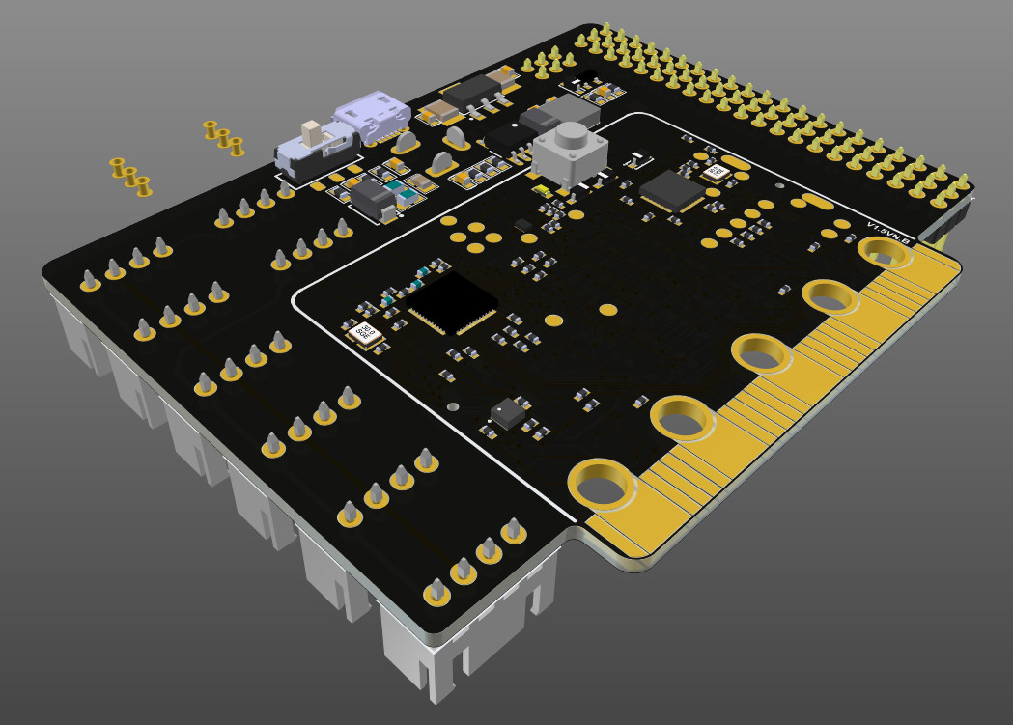
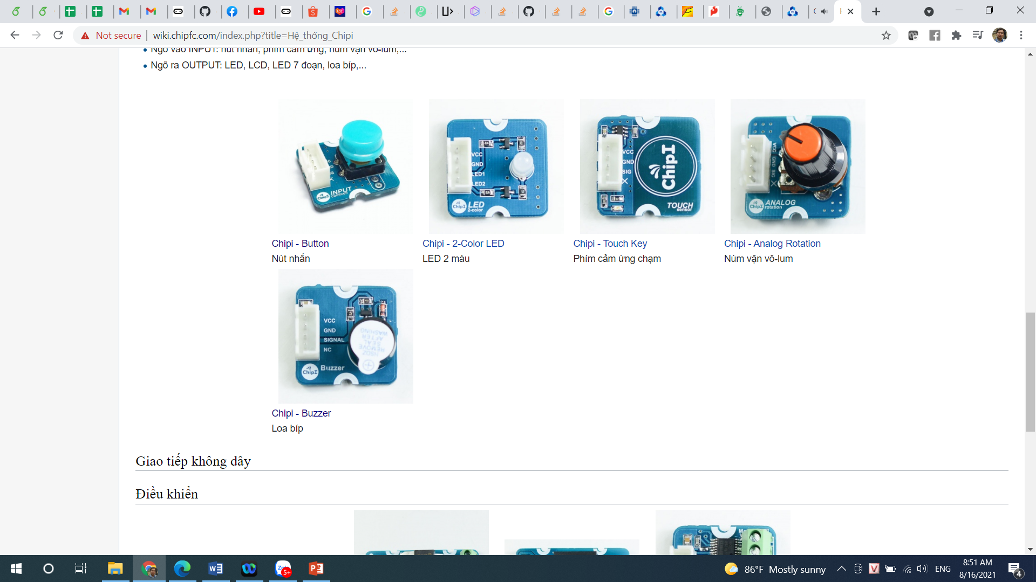
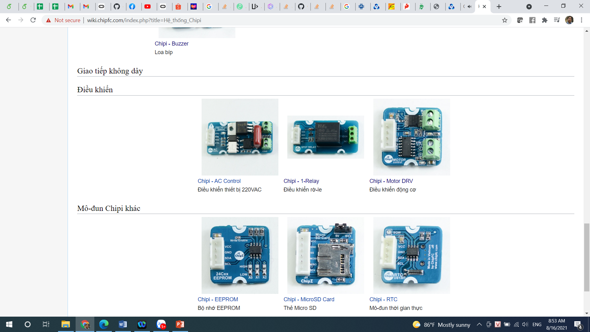
Some projects

Slide 5
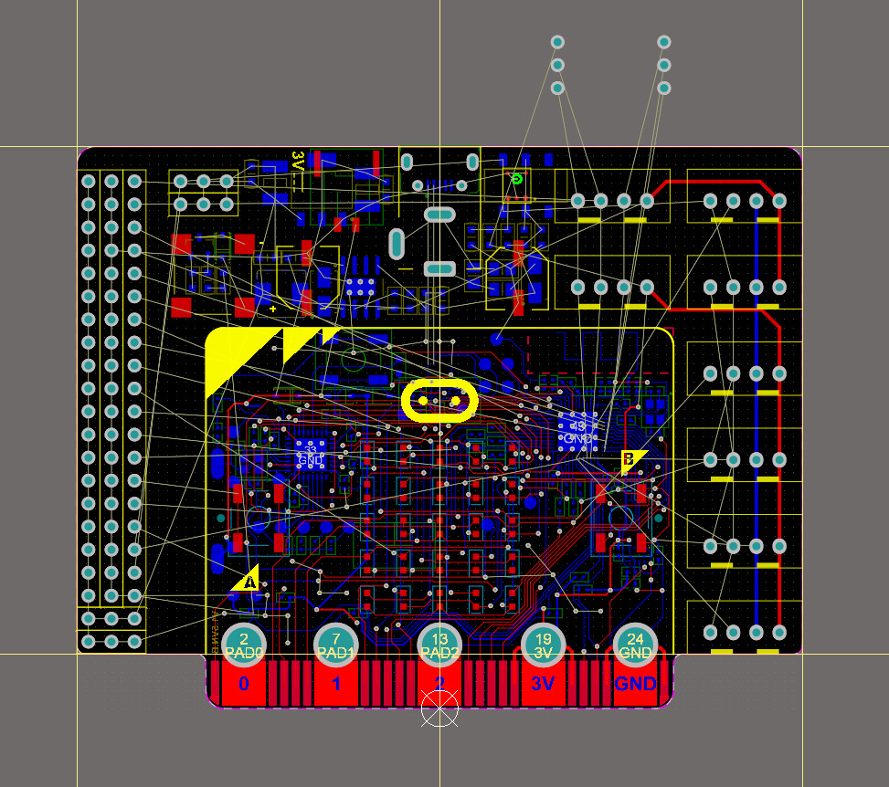
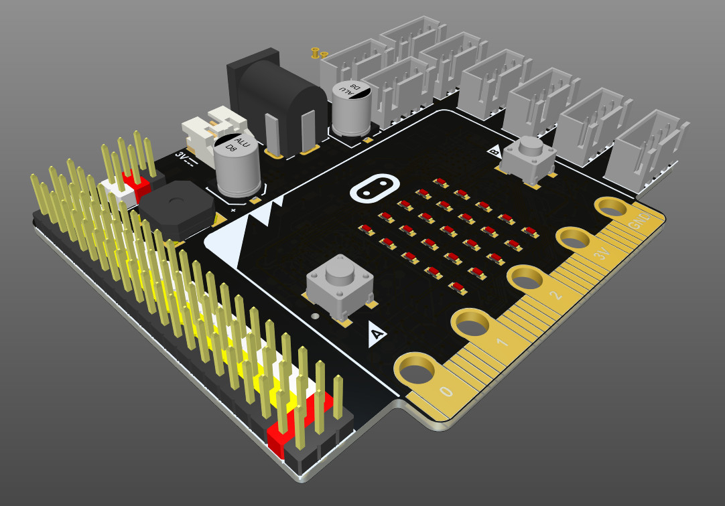
Complicated Project
https://ubc.sgp1.cdn.digitaloceanspaces.com/Altium/Altium%20Designer%2020.1.11%20Build%20218.zip

Slide 6
Basic Electronic Circuit Components
Wires, Cables, and Connectors
Batteries
Switches
Resistors
LED (Light Emitted Diode)
Exercises
Pull up and Pull down resistors

Slide 7
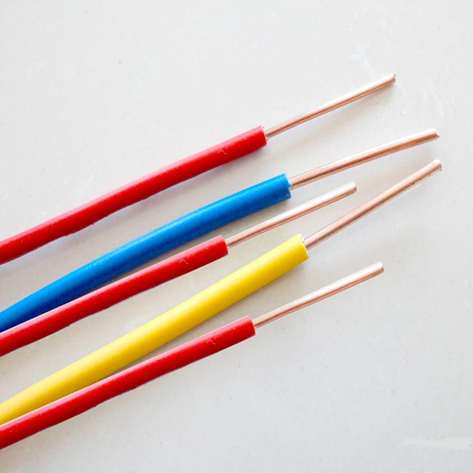
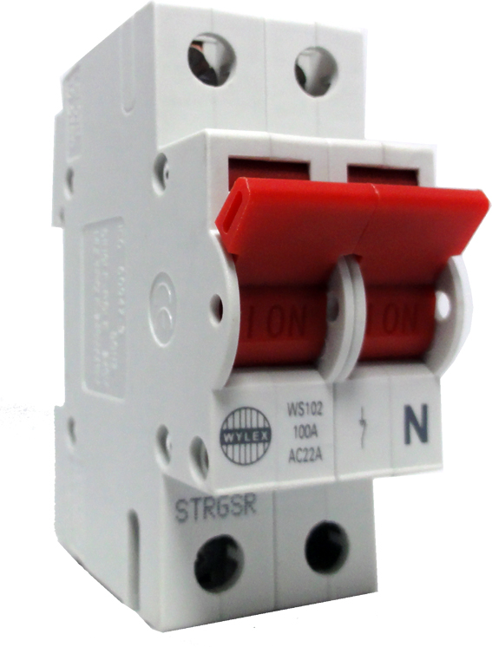
Solid Core Wires
Strong
High current

Slide 8

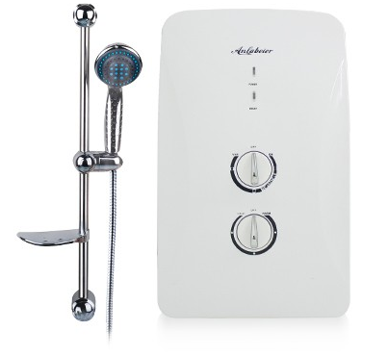
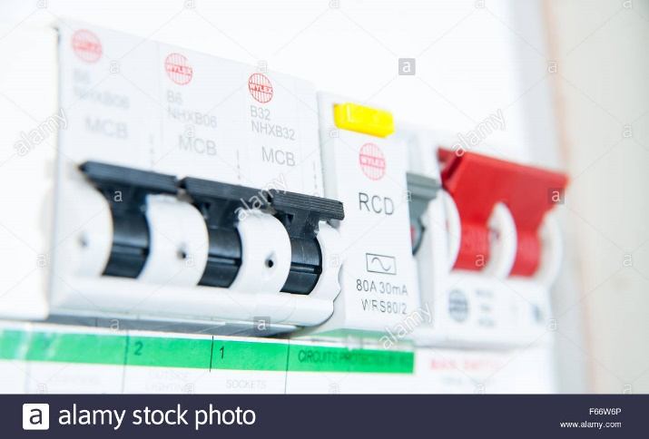
Solid Core Applications

Slide 9
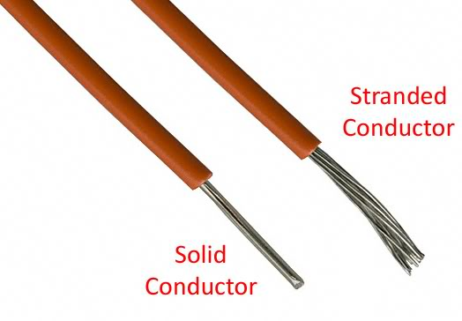
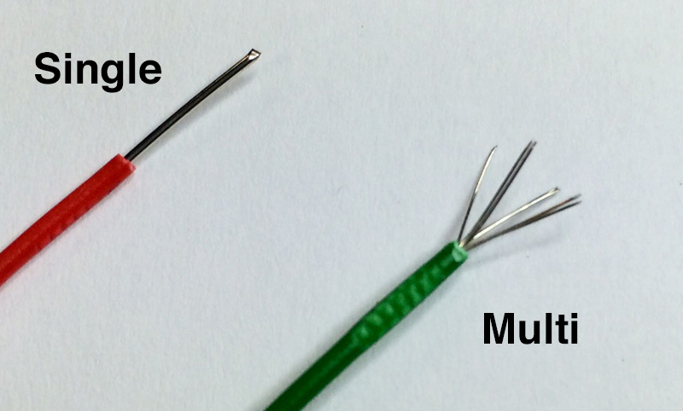
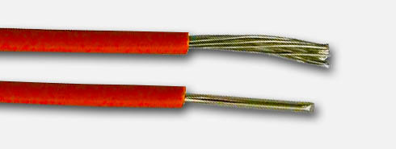
Stranded Wires (Multicore Wires)
Soft
Smaller current
Easy to Draw

Slide 10

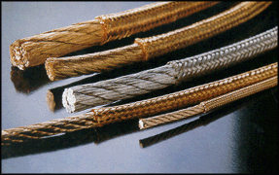
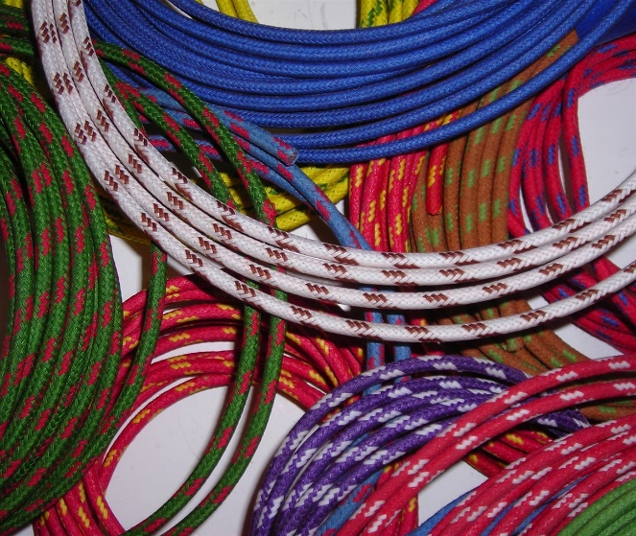
Braided Wires
Soft and High current

Slide 11
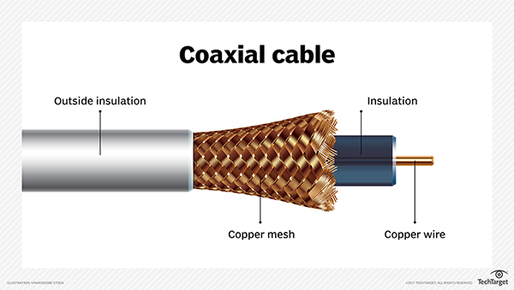
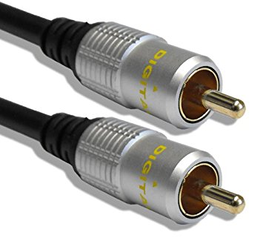
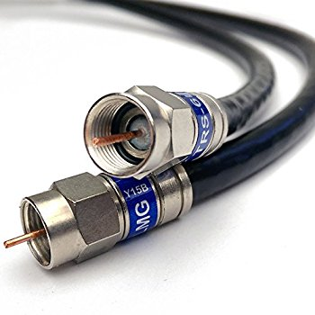

Coaxial Cables
High speed communication systems

Slide 12
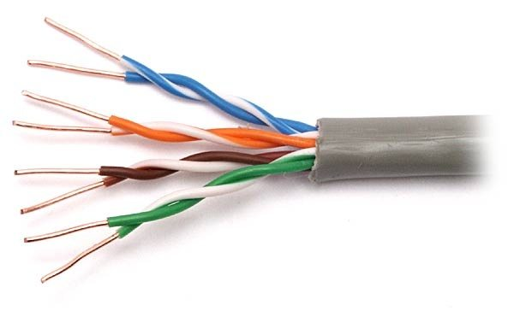
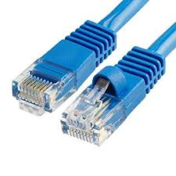

Twisted Pair Cables
Pulse noise avoidance
ADSL Modem (RJ45)

Slide 13
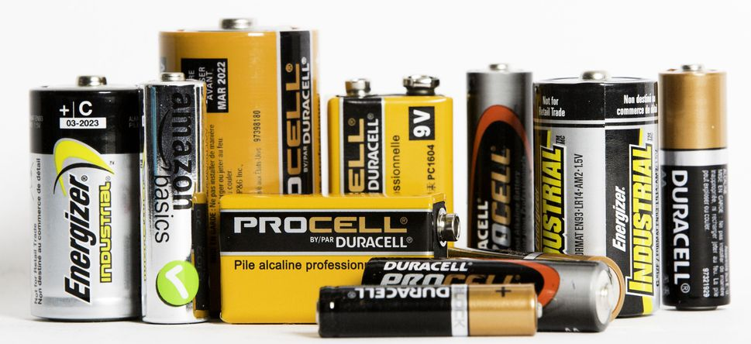
Battery
The most popular storage device

Slide 14
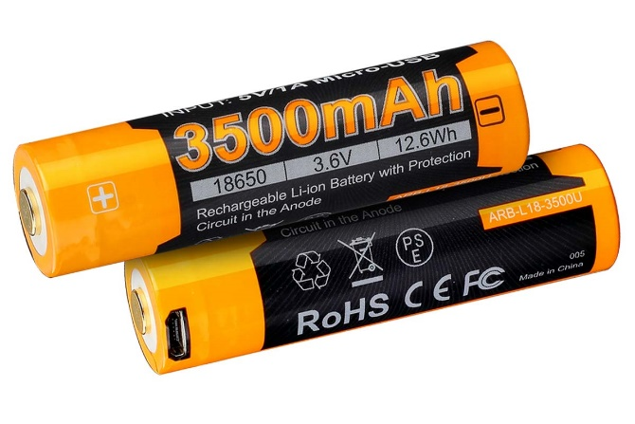

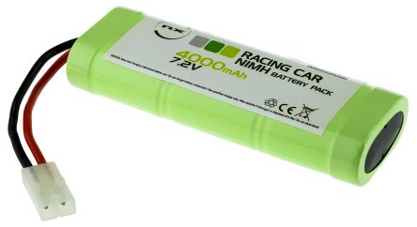
Rechargeable Batteries
Battery capacity: 3500mAh

Slide 15
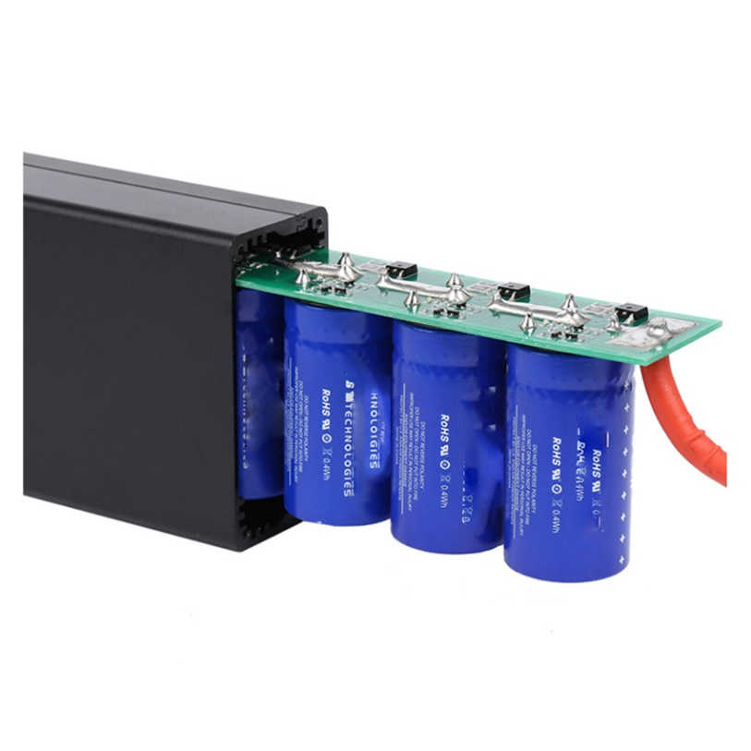
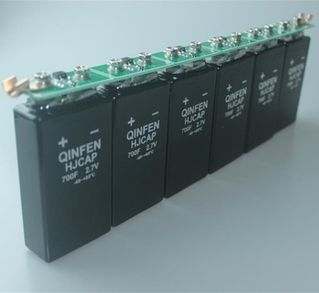
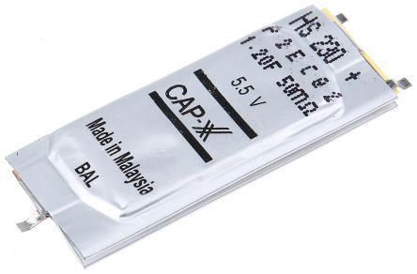
Super Capacitors

Slide 16
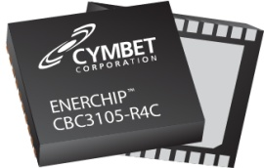
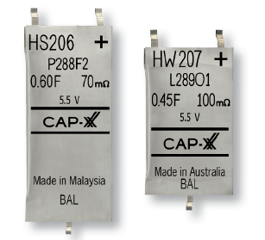
Rechargeable Batteries vs Super Capacitor
500 recharge cycles
Difficult to estimate the state of charge
Low leakage current
[Cymbet ]
500 000 recharge cycles
Easy to estimate the state of charge
High leakage current
[CapXX]

Slide 17
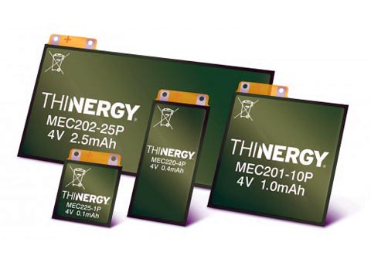
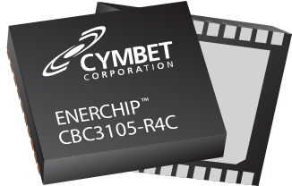
New Generation of Batteries
IC Rechargeable Batteries
Hybrid Batteries (Batteries + Capacitors)

Slide 18
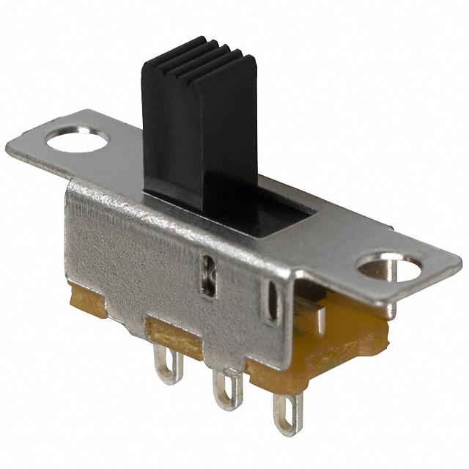
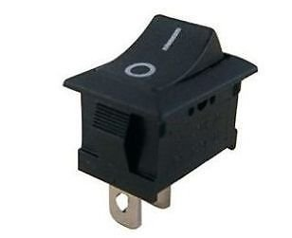
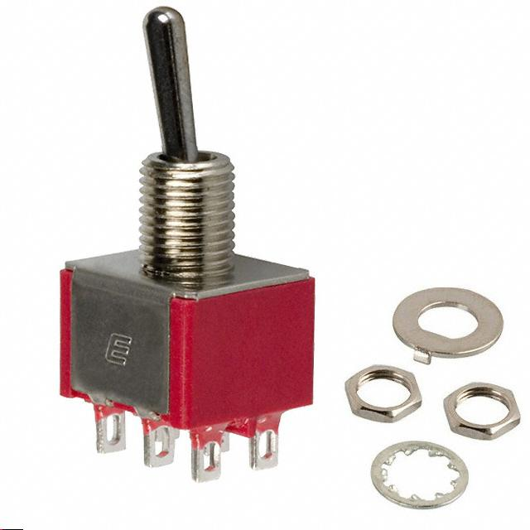
Switch
A switch is a mechanical device that interrupts or diverts electric current flow within a circuit

Slide 19
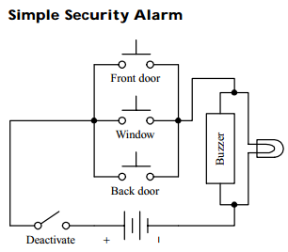
Switch Applications (1)
Here’s a simple home security alarm that’s triggered into action (buzzer and light go on) when one of the normally open switches is closed. Magnetic reed switches work particularly well in such applications.

Slide 20
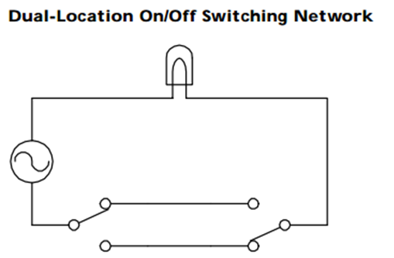
Switch Applications (2)
Here’s a switch network that allows an individual to turn a light on or off from either of two locations. This setup is frequently used in household wiring applications.

Slide 21
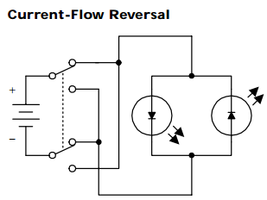
Switch Application (3)
A DPDT switch, shown here, can be used to reverse the direction of current flow. When the switch is thrown up, current will flow throw the left light-emitting diode (LED). When the switch is thrown down, current will flow throw the right LED. (LEDs only allow current to flow in one direction.)
SW₁
LED₁
LED₂
SW₂

Slide 22
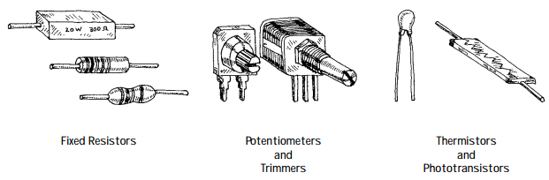
Resistors
Resistors are electrical devices that act to reduce current flow and at the same time act to lower voltage levels within circuits.
The relationship between the voltage applied across a resistor and the current through it is given by V =IR.
Resistors may have fixed resistances, or they may be designed to have variable resistances. They also may have resistances that change with light or heat exposure (e.g., photo-resistors, thermistors).

Slide 23
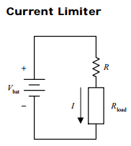
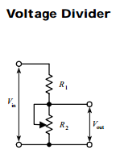
Resistors

Slide 24
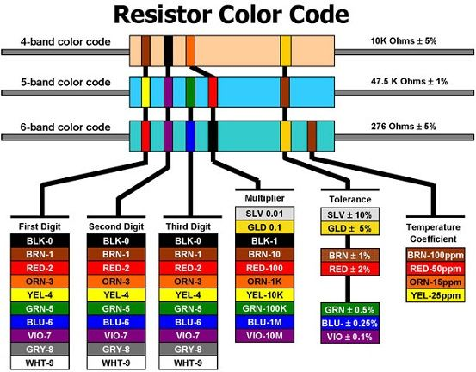
Understanding Resistor Labels

Slide 25
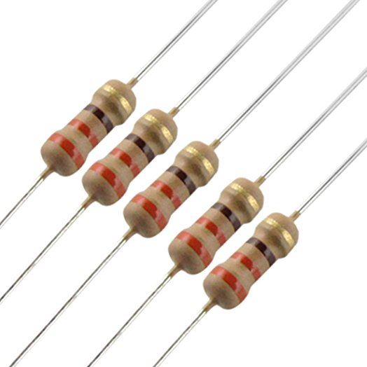
Examples

Slide 26
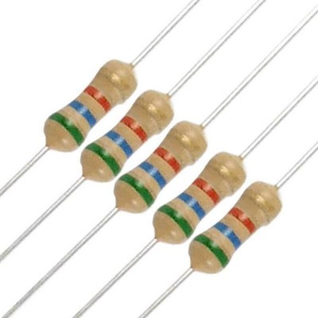
Examples

Slide 27
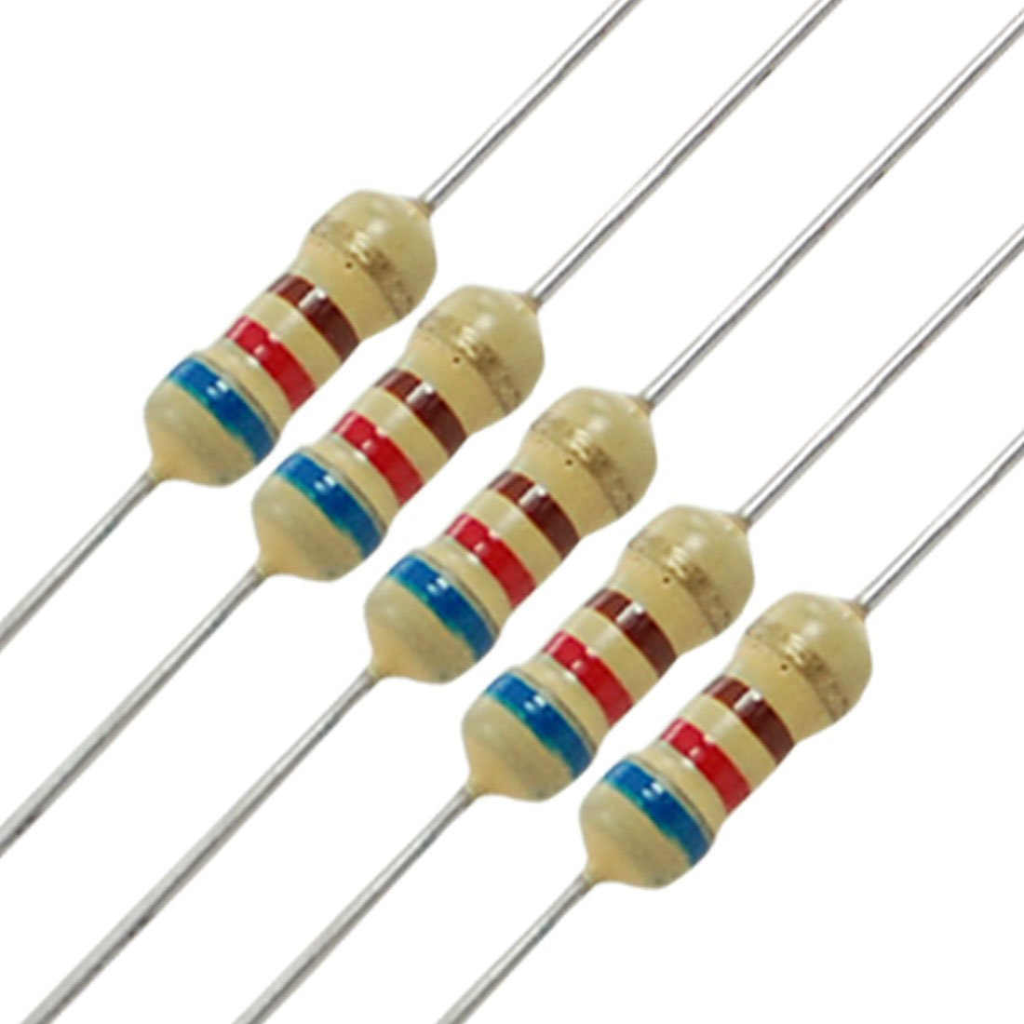
Examples

Slide 28
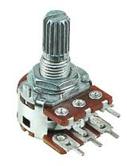
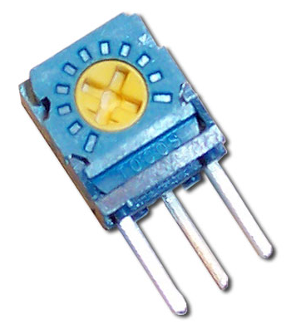
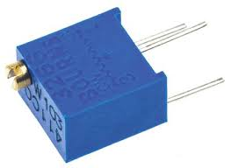
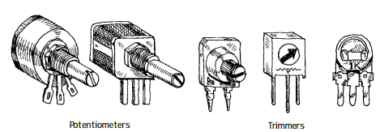
Variable Resistors
Special kinds of variable resistors include
Potentiometers;
Rheostats; and
Trimmers.
Potentiometers and rheostats are essentially the same thing, but rheostats are used specifically for high-power ac electricity, whereas potentiometers typically are used with lower-level dc electricity. Both potentiometers and rheostats are designed for frequent adjustment.
Trimmers, on the other hand, are miniature potentiometers that are adjusted infrequently and usually come with pins that can be inserted into printed-circuit boards.

Slide 29


Photo-Resistors and Thermistors

Slide 30




Light Emitted Diode (LED)

Slide 31


Optical Touch LED Matrix

Slide 32


LED and Resistor Calculation

Slide 33


LED and Resistor Calculation

Slide 34


LED Applications

Slide 35

Exercise 1
Analyze the circuit

Slide 36

Exercise 2

Slide 37
An LED which has the characteristics shown in this graph is to be used in the circuit below in which both VS and R can be varied. For this LED the switch on voltage (VD) is 1.7 volt which produces a current of 10 mA at which point the LED will just glow dimly. Let us say that the LED operates brightly at 40 mA, but will fail if the current exceeds 90 mA for too long.
Initially the power supply is set at Vs = 6V. What value is required for the resistor so that the LED operates at 40 mA?
If a current of 20 mA is flowing and the resistor is 200 Ohm, what is the supply voltage?
Find the minimum value of the resistor that could be used without damaging the LED

Slide 38


Pull Up and Pull Down Resistor
Pull-up and Pull-down resistors are used to correctly bias the inputs of digital gates to prevent them from floating about randomly when there is no input condition

Slide 39

Pull-up Resistors
Short circuit
Good connection

Slide 40



Calculating Pull-Up Resistor Value
TTL 74LSxxx series:
Input high: V_{IH(min)} = 2.0V, I_{IH} = 20µA
Input low: V_{IL(max)} = 0.8V, I_{IL}= 0.4mA
Single Gate Pull-up Resistor Value
Multiple Gate Pull-up Resistor Value (10 inputs)
Notes:
For a high logic, the voltage must be higher than VIH Min and I IH

Slide 41

Calculating Pull-Up Resistor Value
A Pull-down resistor works in the same way as the previous pull-up resistor, except this time the logic gates input is tied to ground, logic level “0” (LOW)

Slide 42
Example
TTL 74LS00 NAND Gates along with a single-pole double-throw switch are to be used to make a simple set-reset bistable circuit signal. Calculate: 1). The maximum pull-up resistor values if the voltage representing a logic HIGH input is to be held at 4.5 volts when the switch is open, and 2). The current flowing through the resistor when the switch is closed (assume zero contact resistance). Also draw the circuit.
Data given: Vcc = 5V, V_{IH} = 4.5V, and I_{IH(max)} = 20μA

Slide 43



Answer
Set-Reset Bistable Circuit

Slide 44

Programming Arduino

Slide 45

Programming on BBC Microbit

Slide 46

Lab Manual
Take randomly 10 resistor pictures
Determine the resistance based on its colors
No | Picture | Value
1 |  | 620Ohm

Slide 47
Circuit Simulation on TINA TI
TINA-TI setup file: http://cse.hcmut.edu.vn/vtphuong/EDAC/Tina90-TIen.exe
Quick manual
https://www.youtube.com/watch?v=u7_RP1f82oo

Slide 48

Arduino Programming
Student can simulate at https://www.tinkercad.com/

